Slide 1
FORM ONE ENGLISH
PREPOSITIONS

Slide 2
Introduction
Look at the following pictures:

Slide 3
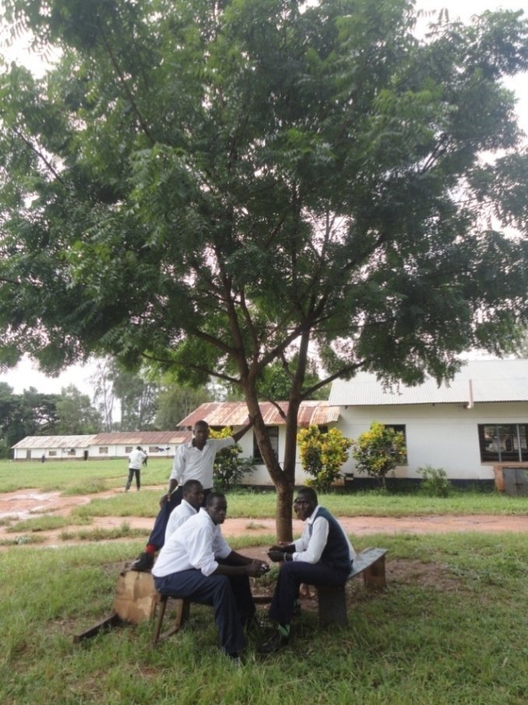
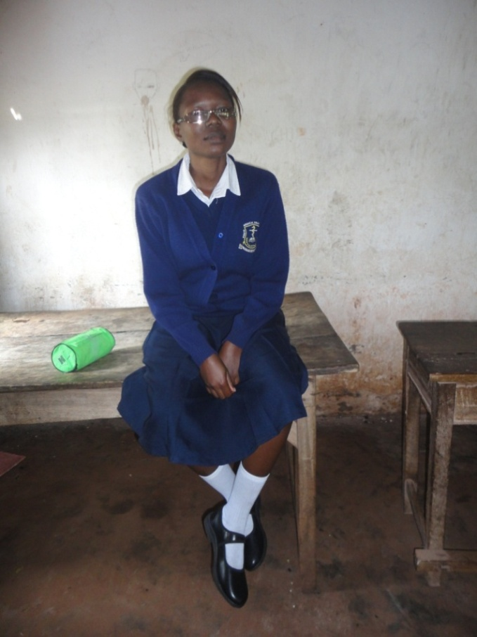
‘’
picture a boys
picture b Grace

Slide 4
‘’
  Activity 1
Where are the boys ?
2.Where is Grace?

Slide 5
‘’
The boys are sitting under a tree
2.Grace is sitting on the table
The words under and on are used before the nouns a tree and the table to show place and position.
These words are called prepositions.

Slide 6
‘’
Prepositions also show: time, direction and method
For example:
1.We shall have a Transparency
Integrity seminar in August (time)
2.The visitors are walking round the school(direction)
3.Our principal will travel by train(method)

Slide 7
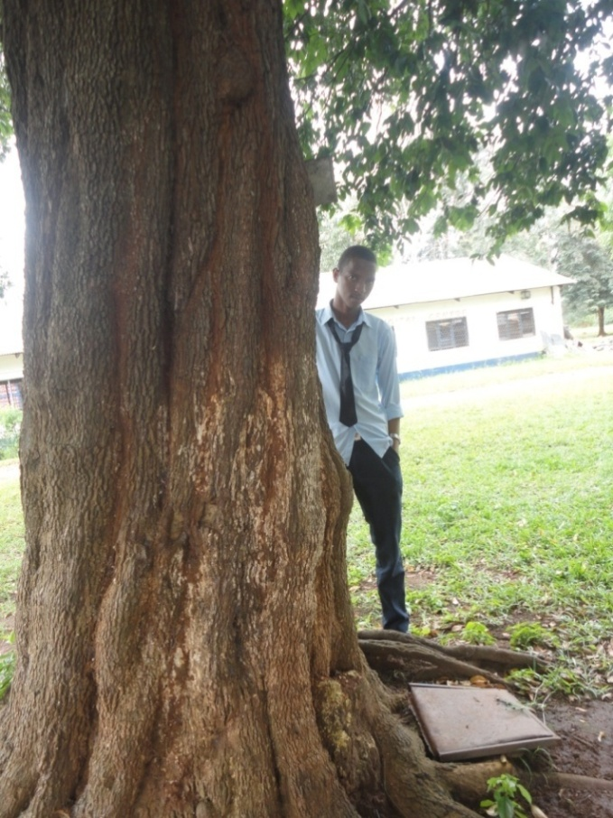
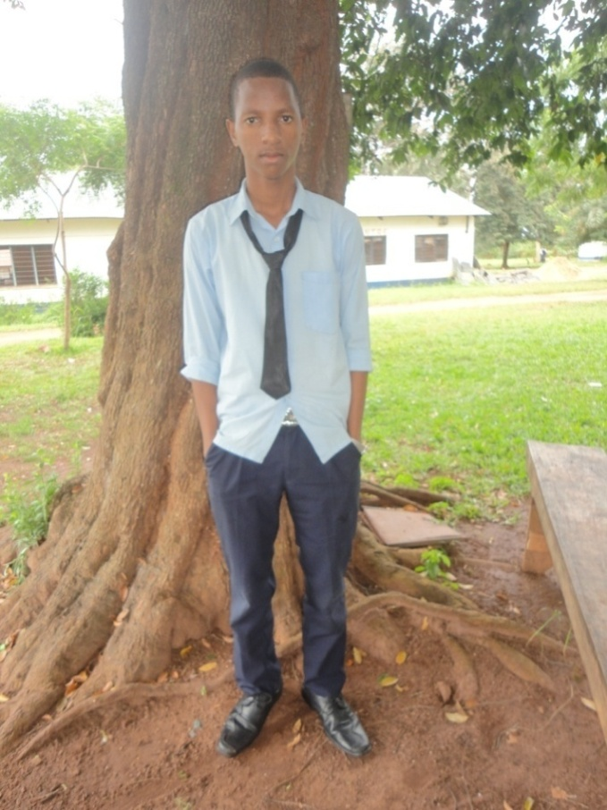
Activity 1b
Where is Jeremiah
Picture A?
Where is Jeremiah
Picture B?

Slide 8
Answers
1 in picture A Jeremiah is behind the tree
2. in picture B Jeremiah is in front of the tree
T he word behind and the phrase in front of are prepositions

Slide 9
Activity 2
Now make nine different sentences
from the following pictures using the
given prepositions .

Slide 10
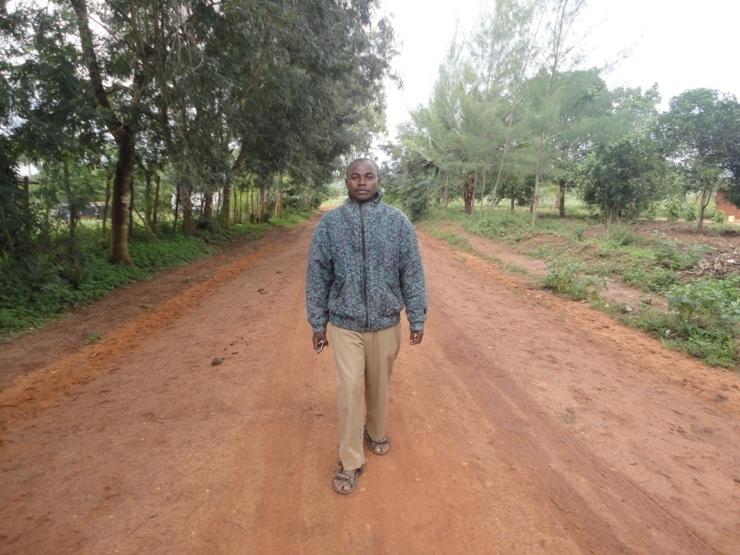
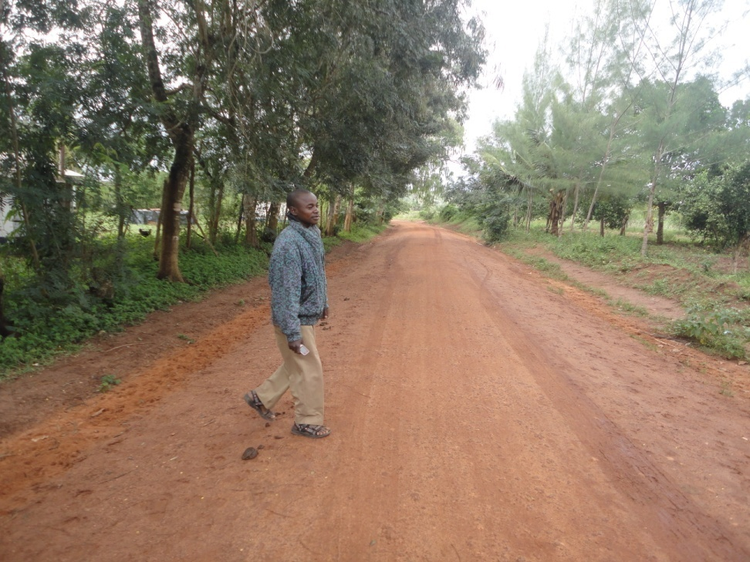
‘’
Picture 1 along
Picture 2 across

Slide 11
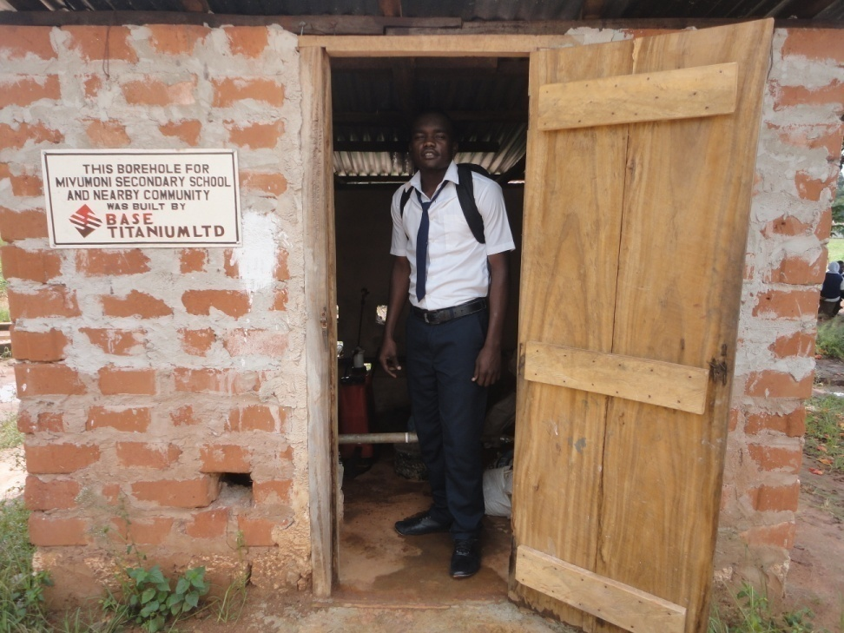
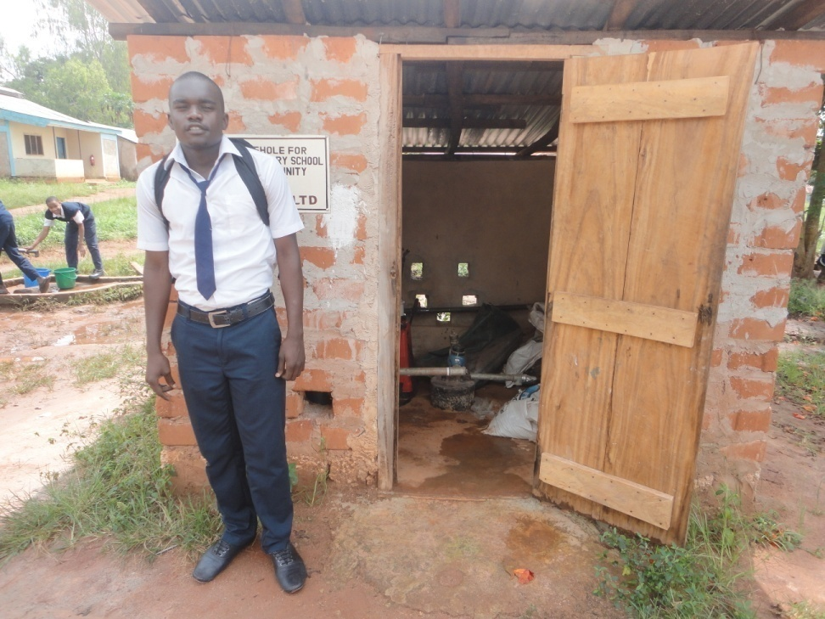
‘’
Picture 3 in
Picture 4 out

Slide 12
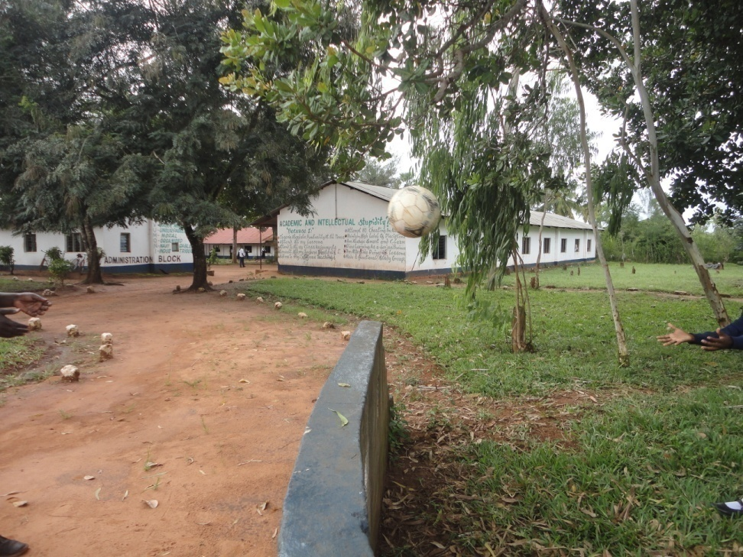
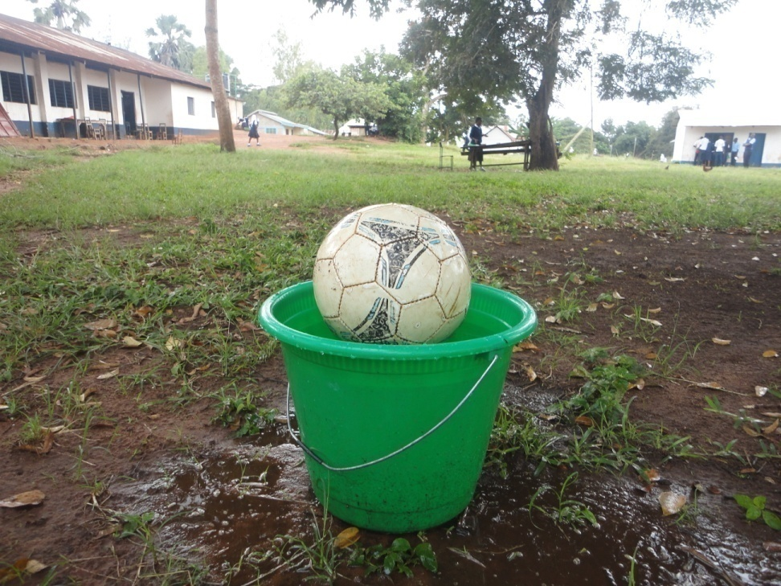
‘’
Picture 5 over
Picture 6 into

Slide 13
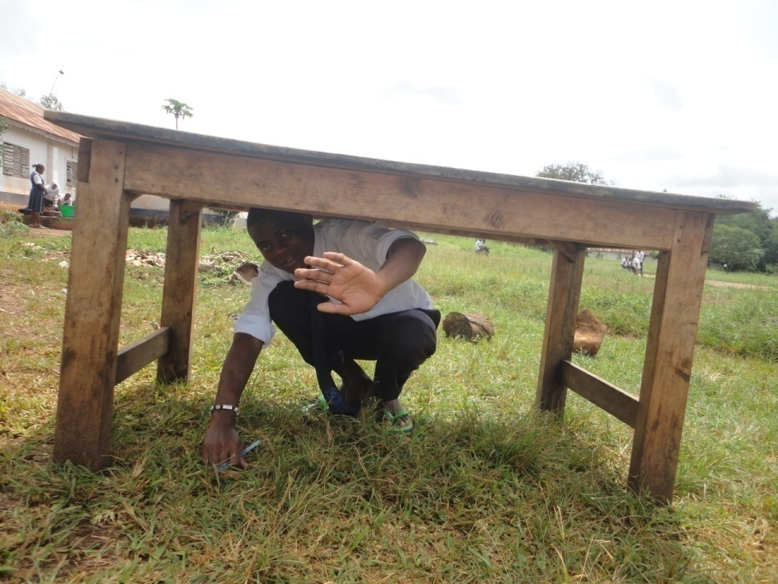
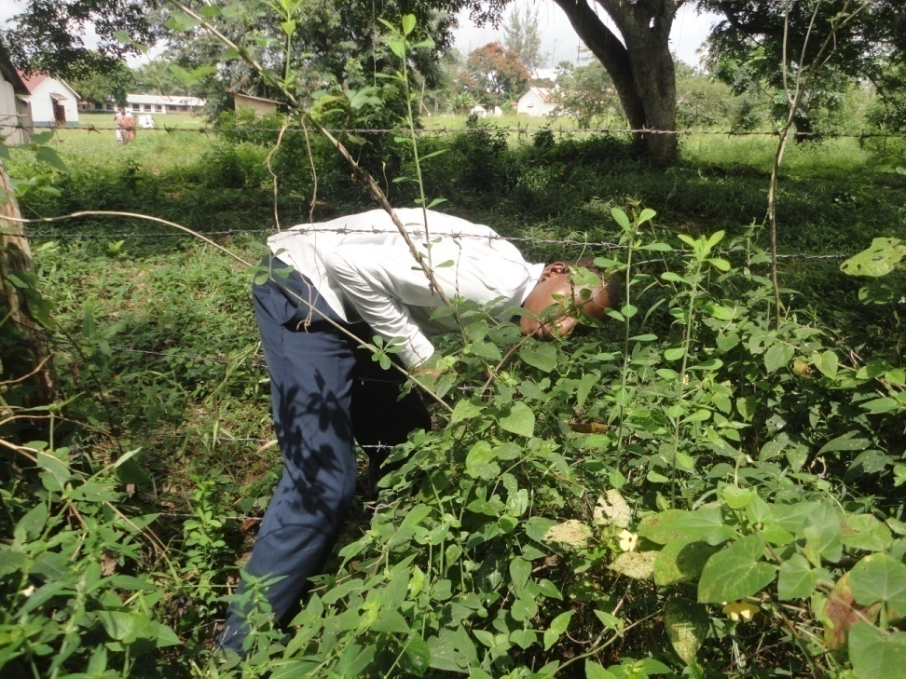
‘’
Picture 6 under
Picture 7 through

Slide 14
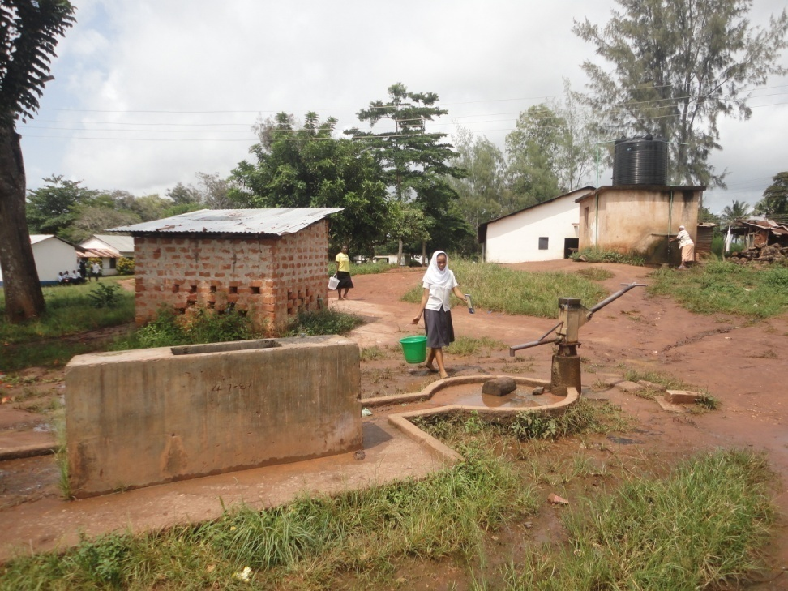
‘’
Picture 8 towards
Activity 3
Identify prepositions in the following sentences:
Tima is walking towards the borehole.
Grace threw the ball into the bucket
The boy was seen going through the fence

Slide 15
Assignment.
Construct sentences using the following prepositions:
Over
Down
Round
From
Up
QUIZQUIZ.htm

Slide 16
Thank you
Lesson presented by
Waneroba D.Watuha
Mivumoni secondary school
Kwale County

